Slide 1
Classifying Dog Breeds with Keras
Abraham Eyman Casey and Sameer Patel
COMP 4449 – Data Science Capstone
Spring Quarter, 2021

Slide 2

Analysis Intent
Assess the Project
Best Plan of Approach
Using a Convolutional Neural Network (CNN) built with Keras to identify dog breeds based on input photos.
Foray into using machine learning methodologies for real-world applications, most prominently image classification
CNN is both the simplest and best machine learning tool to accomplish the task
Existing framework for converting images into numerical data able to be processed by the network
Plan
Exploratory Data Analysis / Preprocessing
Model Building
Model Evaluation
Conclusion / Future Analyses

Slide 3
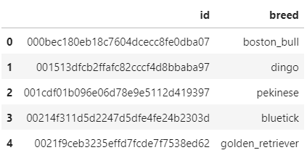
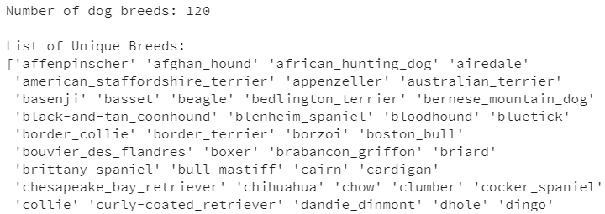
Dataset Source and Description
The data set contains a labeled training set and an unlabeled test set of images of dogs
Exclusively use the labeled set, with a test set split from it for the purposes of model evaluation
Over 10,000 images, spread over 120 dog breeds

Slide 4
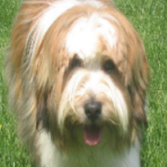
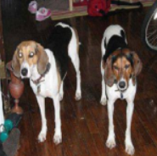

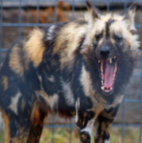
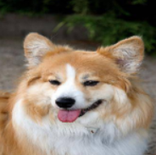
Exploratory Data Analysis (EDA)
Because the data is explicitly labeled images of dog breeds, graphic options for EDA are somewhat limited.
Examine range of image types (e.g. pictures with multiple dogs, varying levels of zoom/blur, other animals, etc)
Evaluate class balance using a histogram of counts

Slide 5
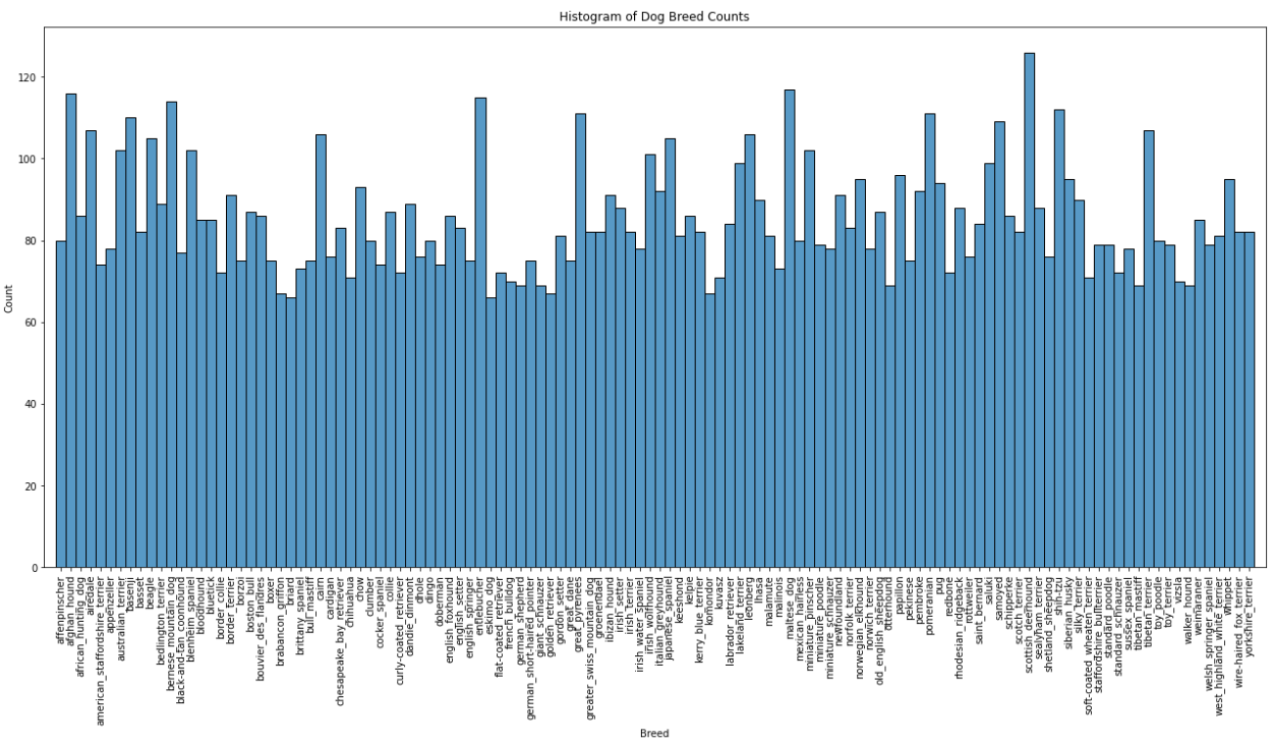
EDA Continued

Slide 6
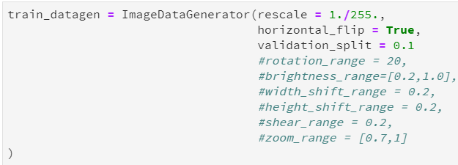
Data Preprocessing
ImageDataGenerator class from the keras library to perform data augmentation
Applies a series of random transformations to each image in the batch
Several transformations are possible, but the additional computational cost is not justifiable for the purposes of this exploration (large training time with base images already)
Opted to only apply the horizontal_flip transformation

Slide 7
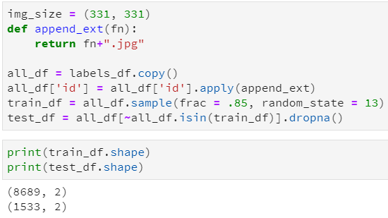
Data Preprocessing (continued)
Split dataset into train and test, using a ratio of 85/15 train/test
Necessary in order to evaluate the model on labeled test data

Slide 8
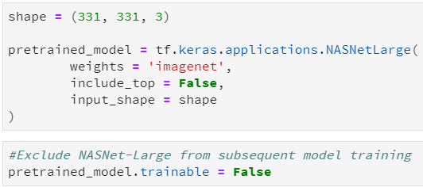
Model Building
Transfer learning as a design methodology
Knowledge of pretrained machine learning model is applied to a different but related problem
Allows savings on both computation and time costs when training a new model
NASNet-Large as a baselayer
Convolutional neural network that is trained on more than a million images from the ImageNet database
Network has already learned rich feature representations for a wide range of images

Slide 9
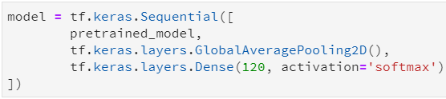
Model Building
Keras model
GlobalAveragePooling2D layer on top of the pretrained model, followed by a Dense layer with 120 nodes for each of the dog breeds represented in the training data
GlobalAveragePooling2D applies average pooling on the spatial dimensions until each spatial dimension is one
Based on research conducted online prior to model construction, GlobalAveragePooling2D is a better choice than Flatten for image classification neural networks

Slide 10
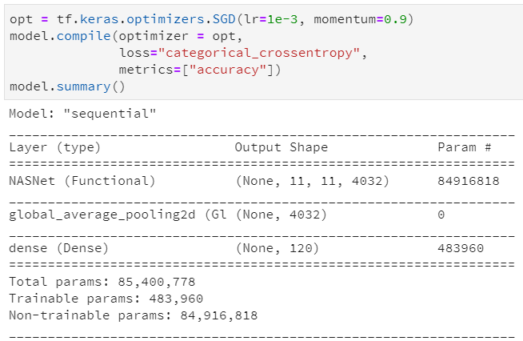
Model Building
Optimizer
Stochastic Gradient Descent (SGD) is often the least memory-intensive
Within SGD, the momentum attribute accelerates gradient descent in the relevant direction and dampens oscillations

Slide 11
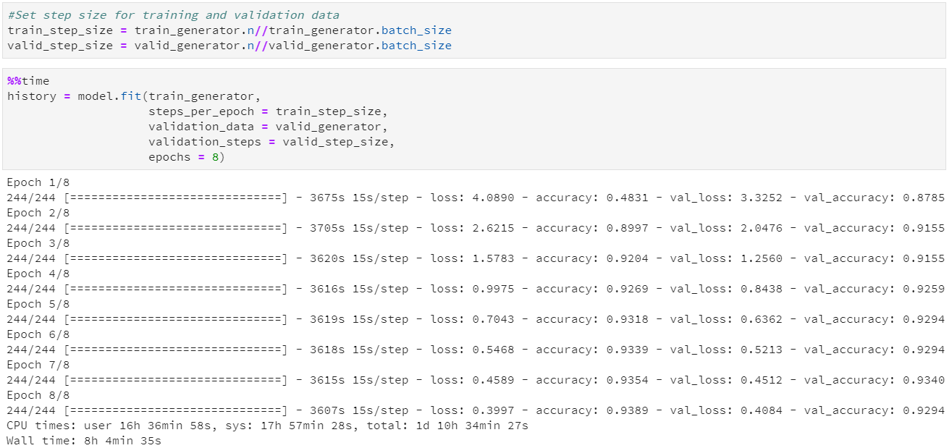
Model Fitting

Slide 12
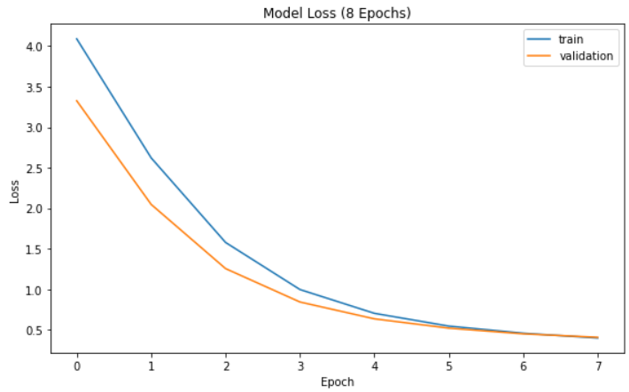
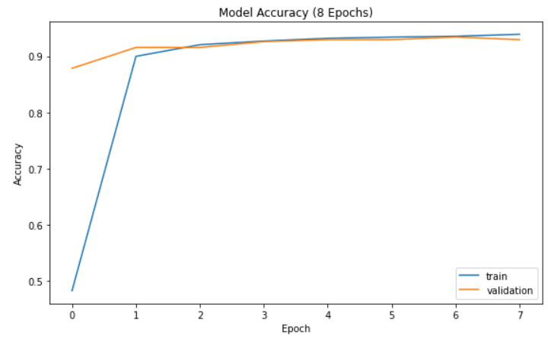
Model Evaluation / Visualizations

Slide 13
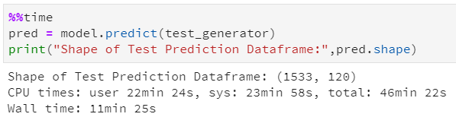
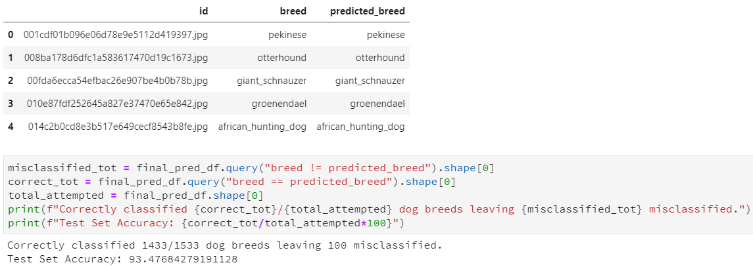
Evaluation on Test Data

Slide 14
Conclusion / Future analyses
The model returned an accuracy of ~93.5% when predicting dog breeds on unseen test data.
Given the large number of classes, the relative similarity in appearance between multiple dog breeds, and the variation of picture inputs, this is an excellent result.
Large-scale hyperparameter tuning was infeasible due to the cumbersome computational complexity and subsequent runtime associated with training the model
Possible routes for future analyses:
Changing the ratio between the training and validation sets
Adding transformations to the ImageDataGenerator class
Changing the model blueprint itself vis a vis adding layers/nodes
Uncountable others

Slide 15

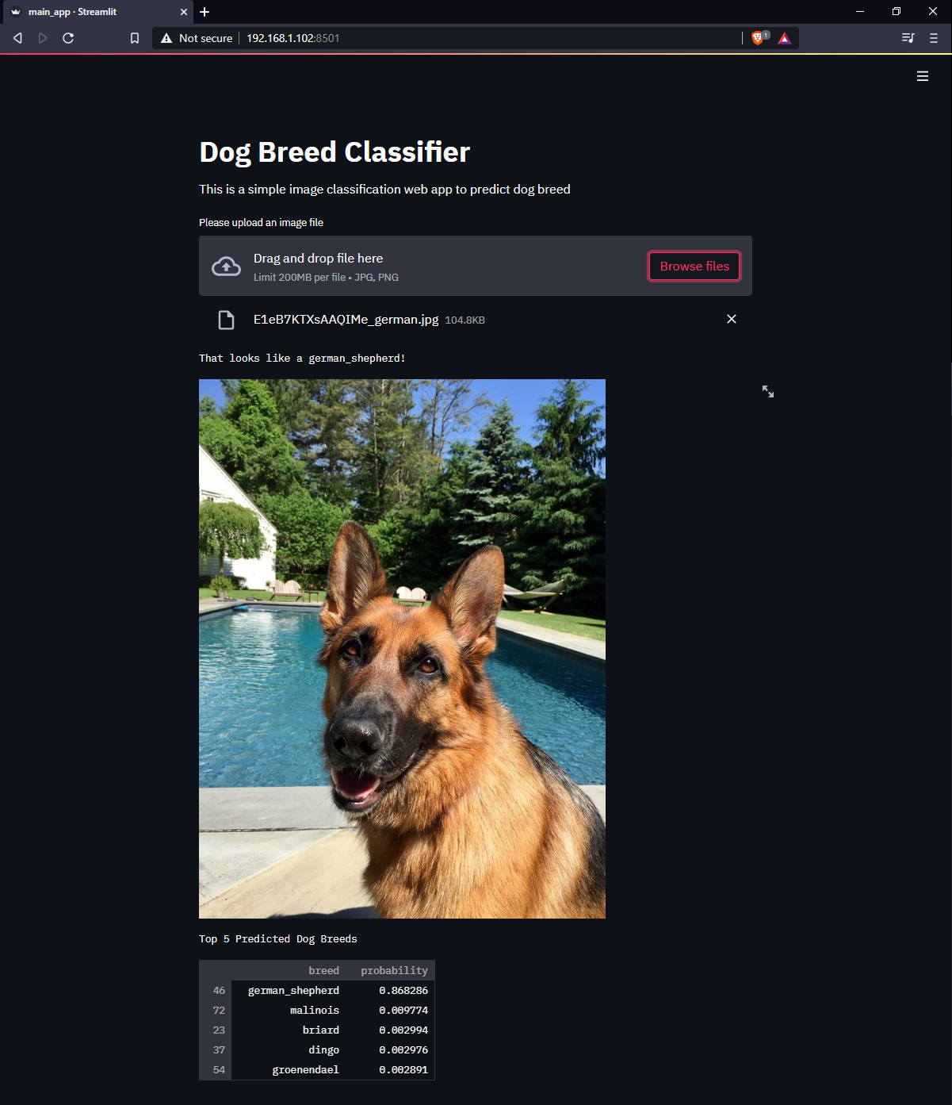
Standalone Web Application
Attempt to bring value to theoretical stakeholders
User can upload a picture of their dog, and the trained model would yield a prediction as to its most-likely breed among the 120 learned breeds

Slide 16
Questions and Comments

